Slide 1
Göttelab report
241111
UNC_UC-London
Shipment #2+3 = 16
Targets: DENV-2; h-mtRNAP
Screening and IC50

Slide 2
DATA:
Screening
DENV-2

Slide 3
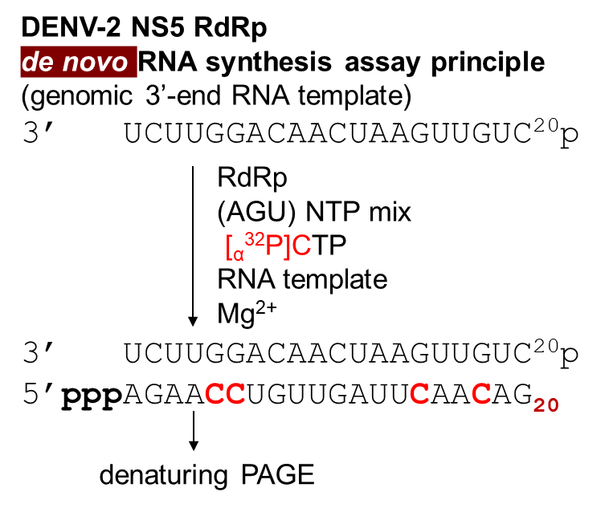
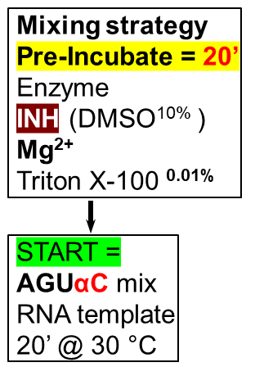
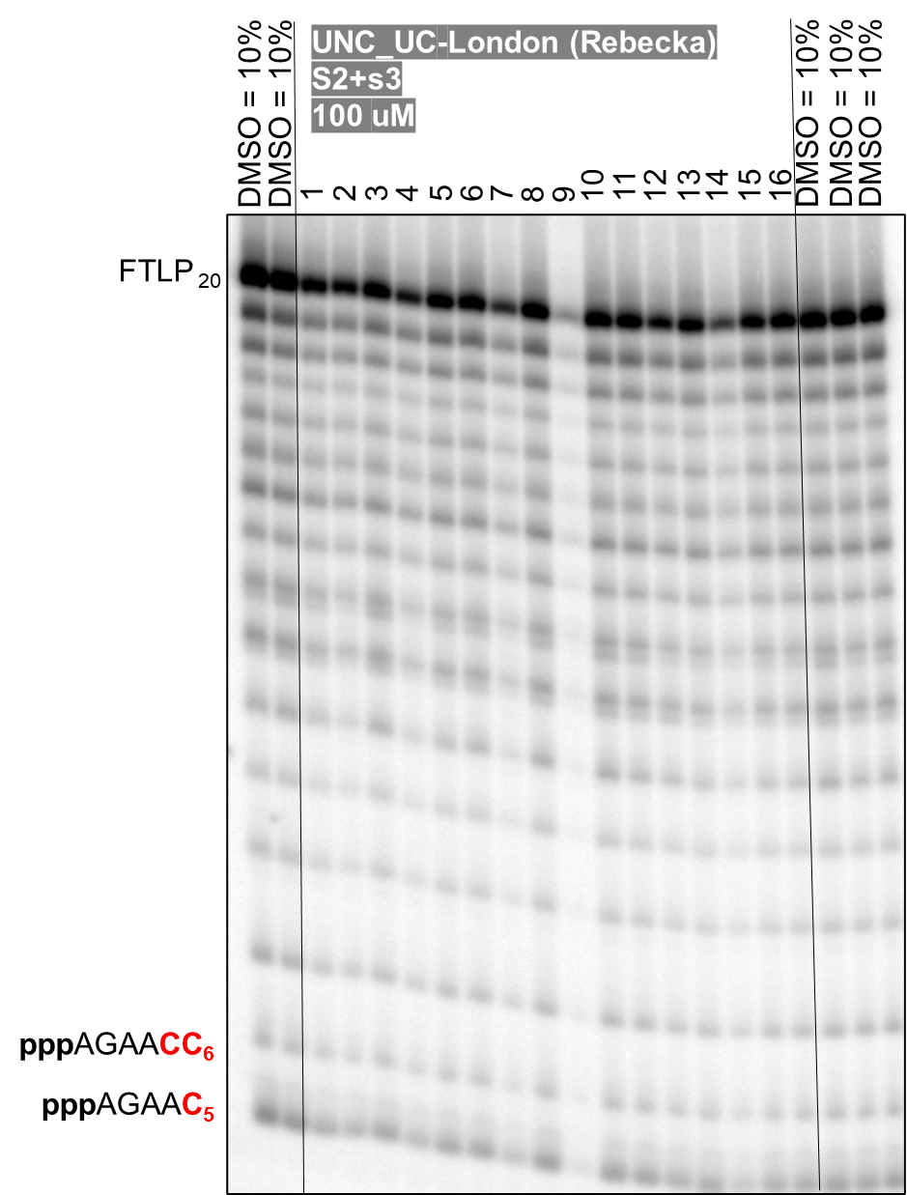
6 = RA-20572
7 = RA-20576
8 = RA-20577

